Slide 1

ProManage: Streamlining Project Management
Welcome! This presentation will explore the concept of ProManage, a project management solution designed for small to medium-sized organizations.

Slide 2
Team Behind ProManage
Hassan Naqvi
Taha Mahmood
Ammar Ahmad
Scrum Master, driving agile development processes.
Developer, bringing ProManage's vision to life.
Product Owner, ensuring the product meets user needs.

Slide 3
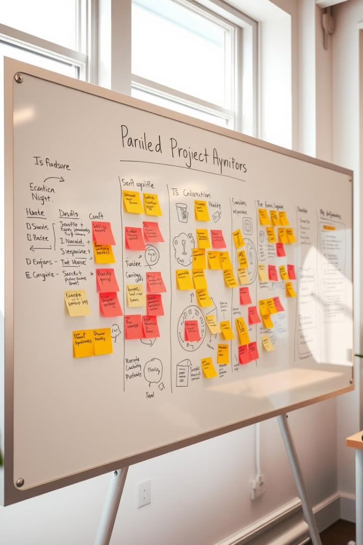
ProManage: Scope
1
Target Group
2
User Base
Small to medium-sized organizations.
Tasks’ administrator and end-users.

Slide 4

ProManage: Objectives
Task Management
Meeting Management
Assign tasks, submission of tasks in form of files, and manage deadlines.
Facilitate communication in form of 1-1 meetings between administrator and end-user.

Slide 5
Functional Requirements
User Management
Task Management
Meeting Management
Account Management
Overall Analytics
Notification System

Slide 6





Non-Functional Requirements
Security
Scalability
Usability
Reliability
Protect sensitive data and ensure user privacy.
Handle increasing user loads and data volume.
Ensure the system is easy to learn and use, intuitive navigation.
Minimize downtime and maintain consistent performance.

Slide 7

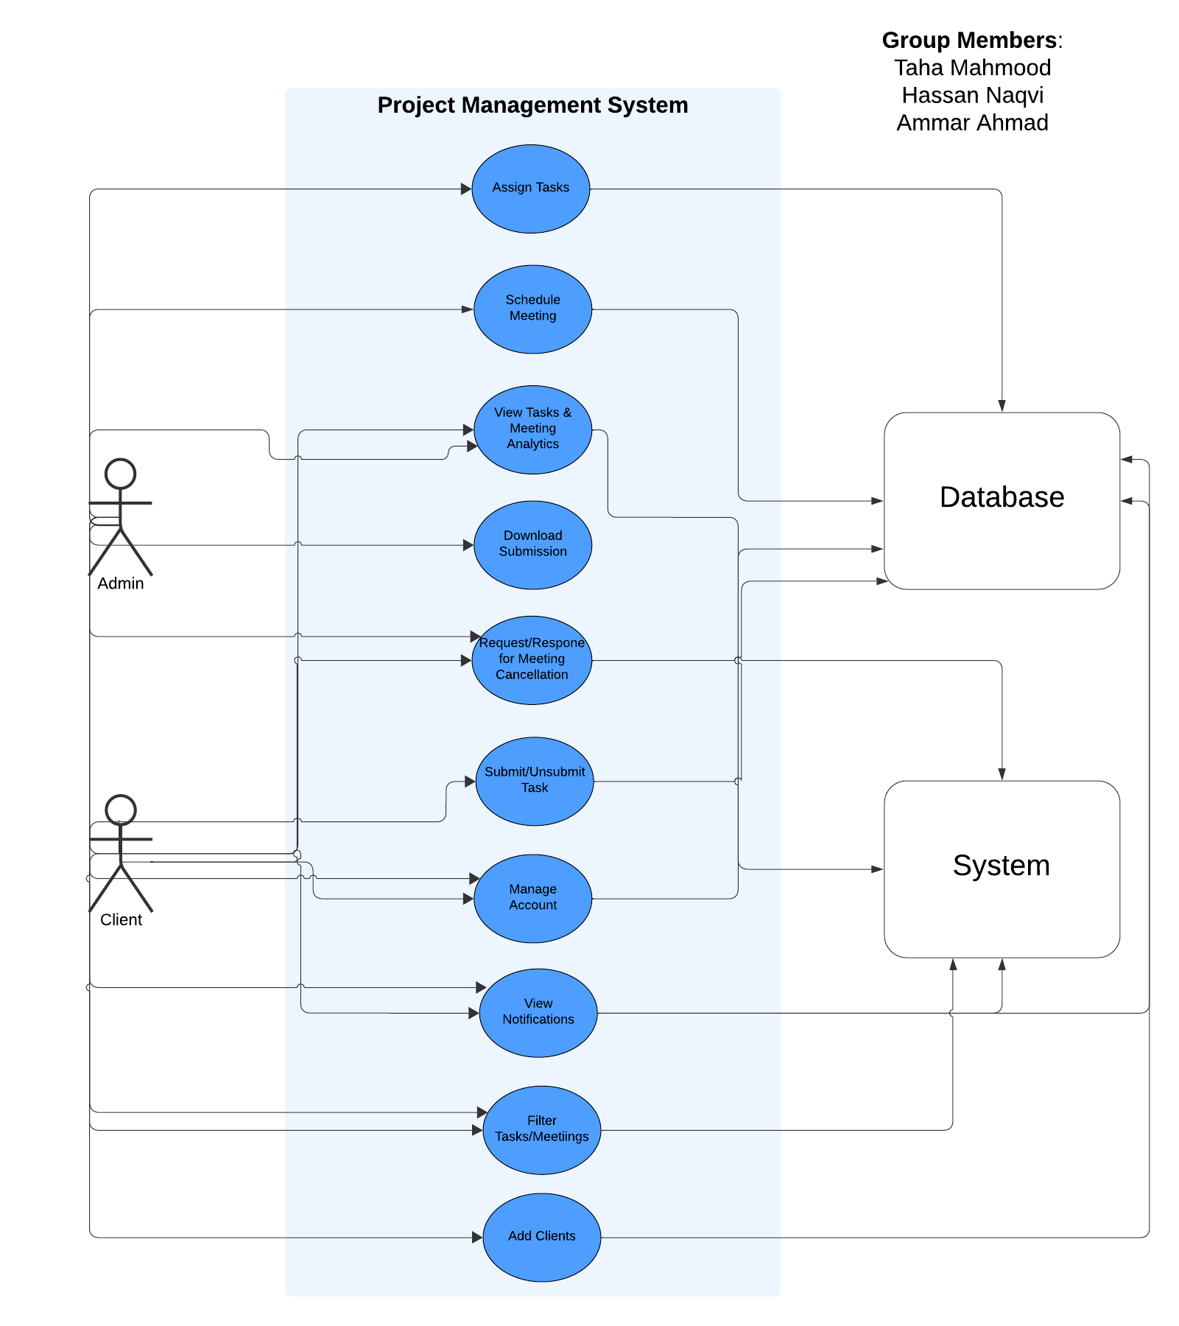
Use Case Diagram
Visual representation of how users interact with ProManage, showcasing various use cases.

Slide 8
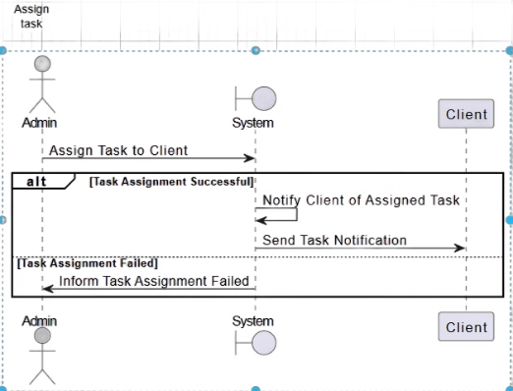
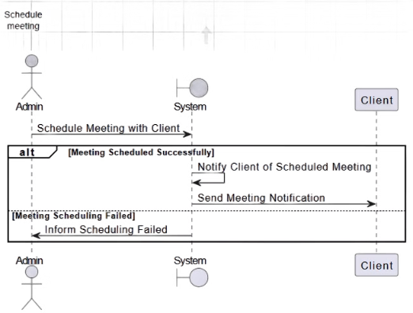
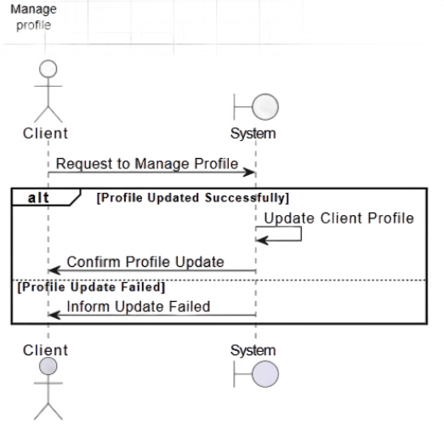
System Sequence Diagrams
Assign Task
Schedule Meeting
Manage Profile

Slide 9
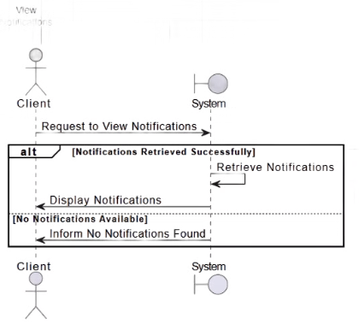
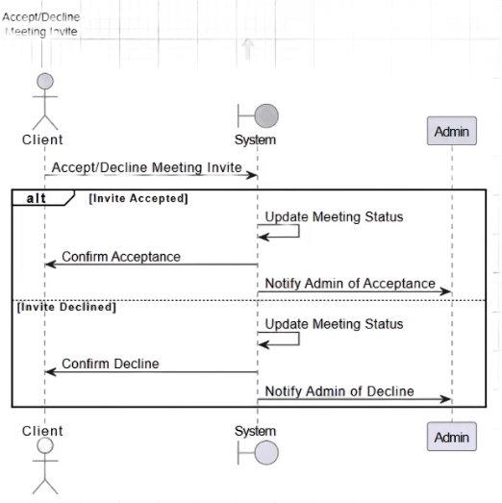
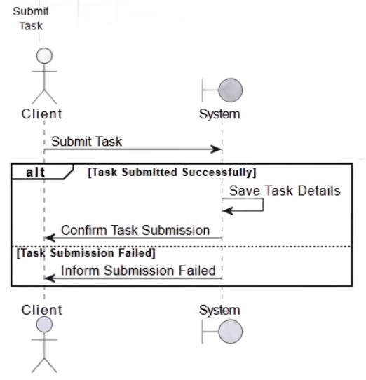
System Sequence Diagrams
View Notifications
Accept/Decline Meeting
Submit Task

Slide 10
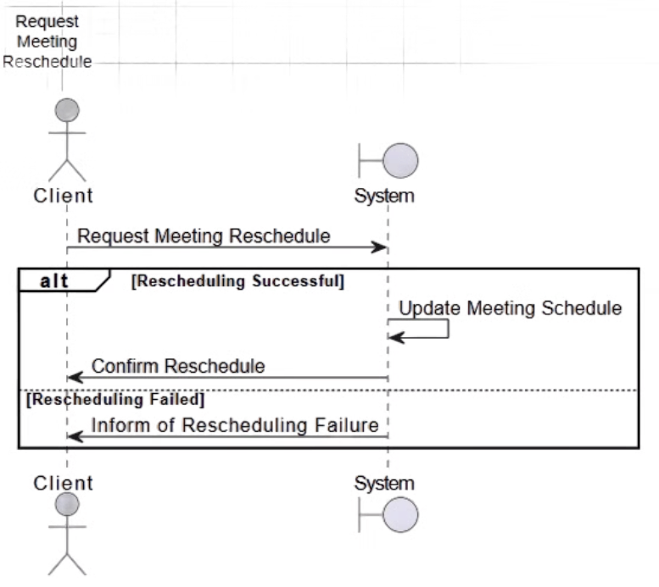
System Sequence Diagrams
Request Meeting Reschedule

Slide 11
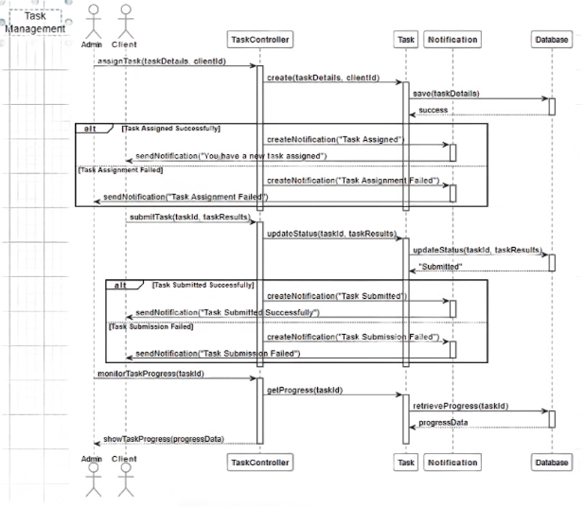
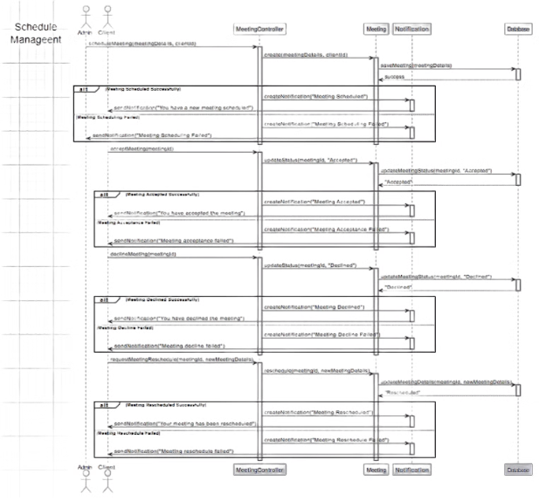
Sequence Diagrams
Task Management Schedule Management

Slide 12
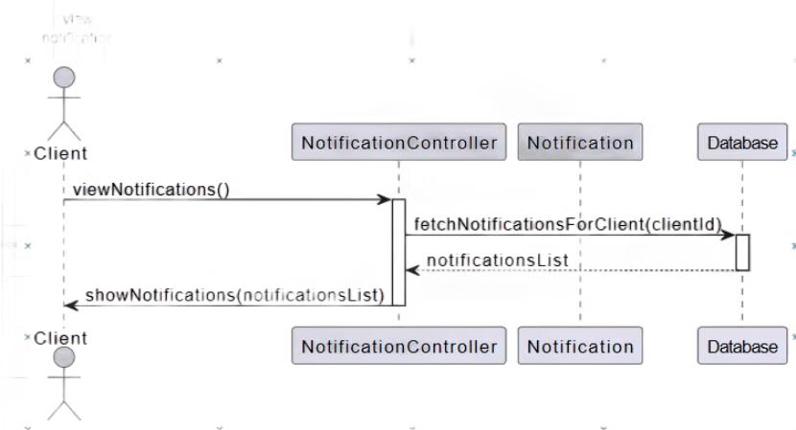
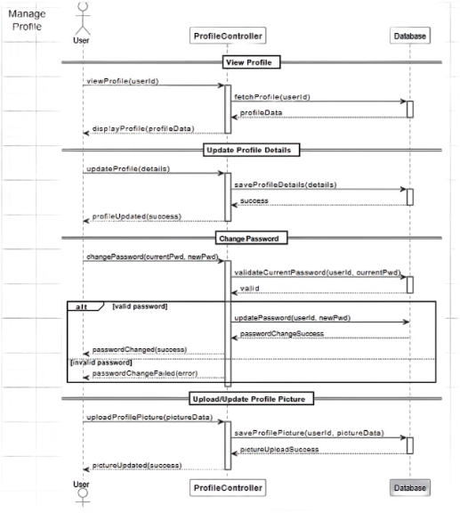
Sequence Diagrams
View Notification Manage Profile

Slide 13
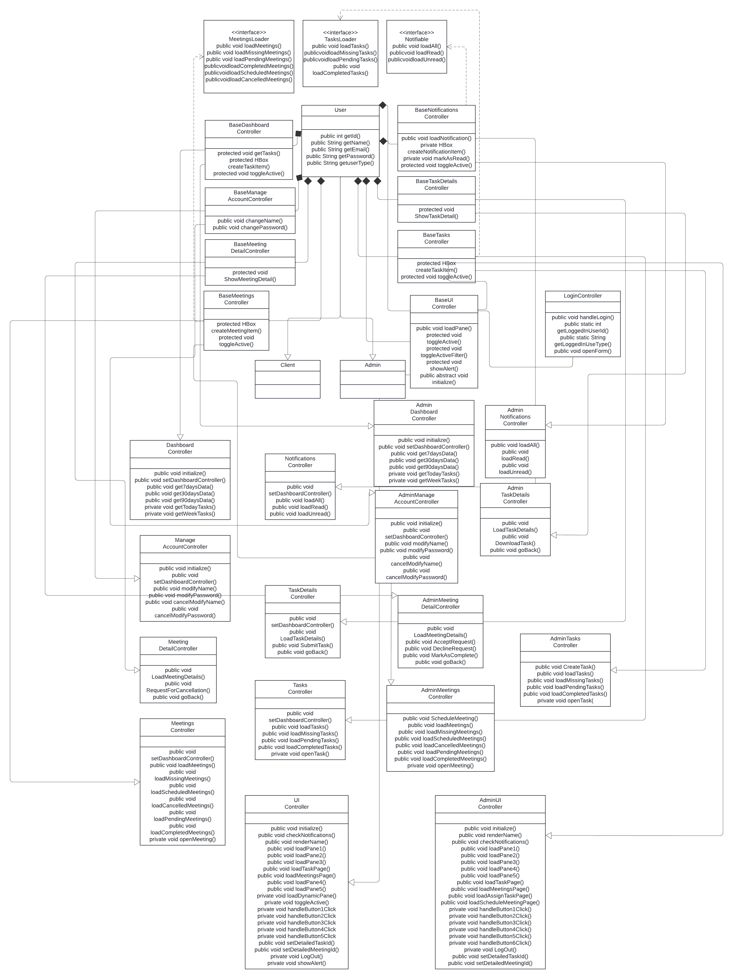
UML Class Diagram
Visual representation of the structure of ProManage, showing the system's key classes, attributes, methods, and their relationships.

Slide 14
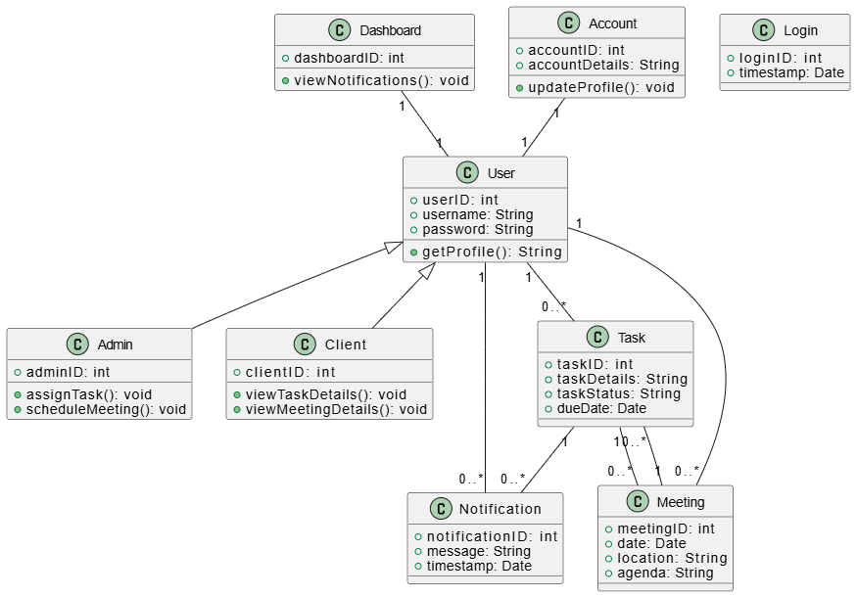
Domain Model
Visual representation of the conceptual entities in ProManage, highlighting their attributes, associations, and relationships within the problem domain.

Slide 15
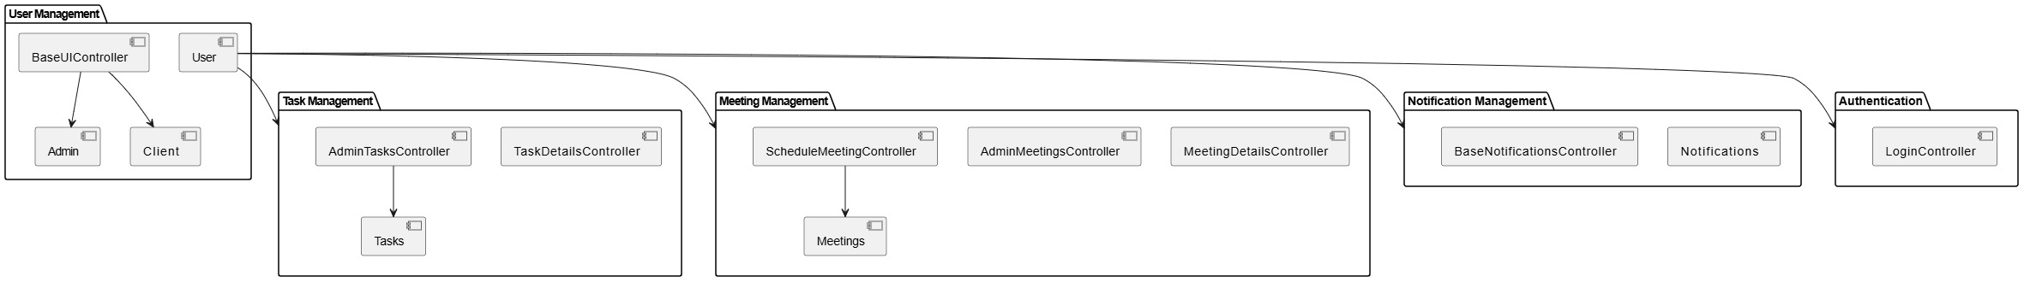
Component Diagram
The Component Diagram provides a visual representation of the high-level components of the ProManage system, showing how these components interact with each other.

Slide 16
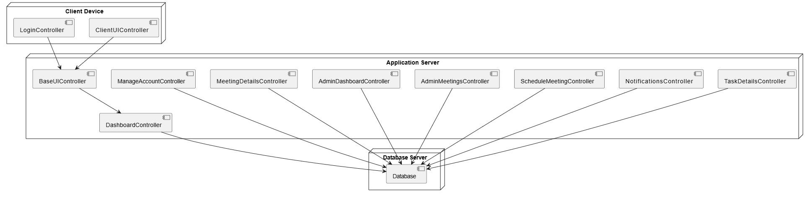
Deployment Diagram
The Deployment Diagram provides a visual representation of the physical infrastructure of the ProManage system, showing how software components are deployed on physical nodes (servers, clients, etc.) in the network.

Slide 17
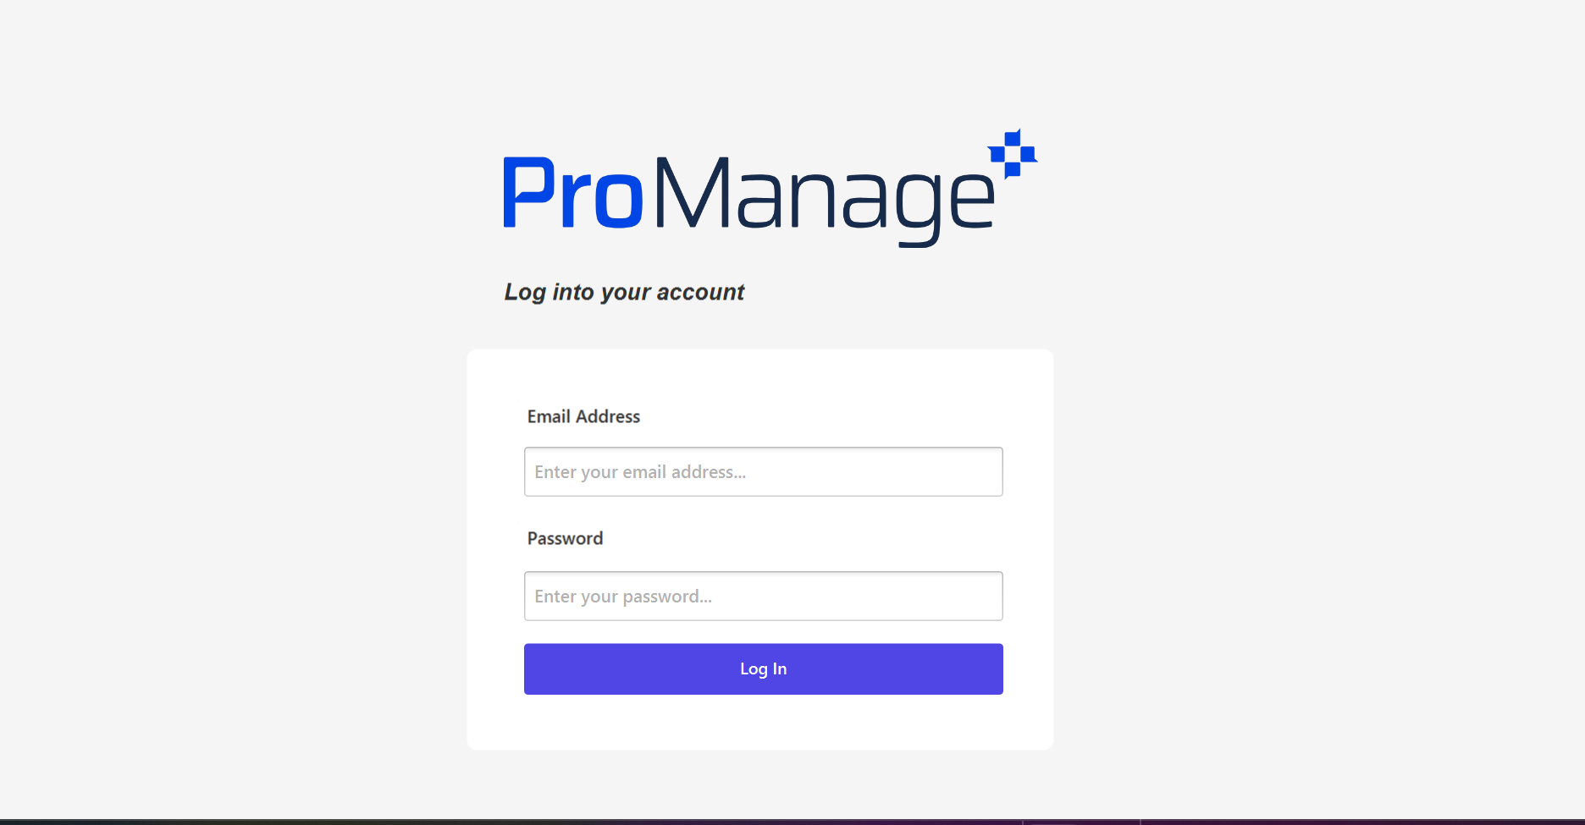
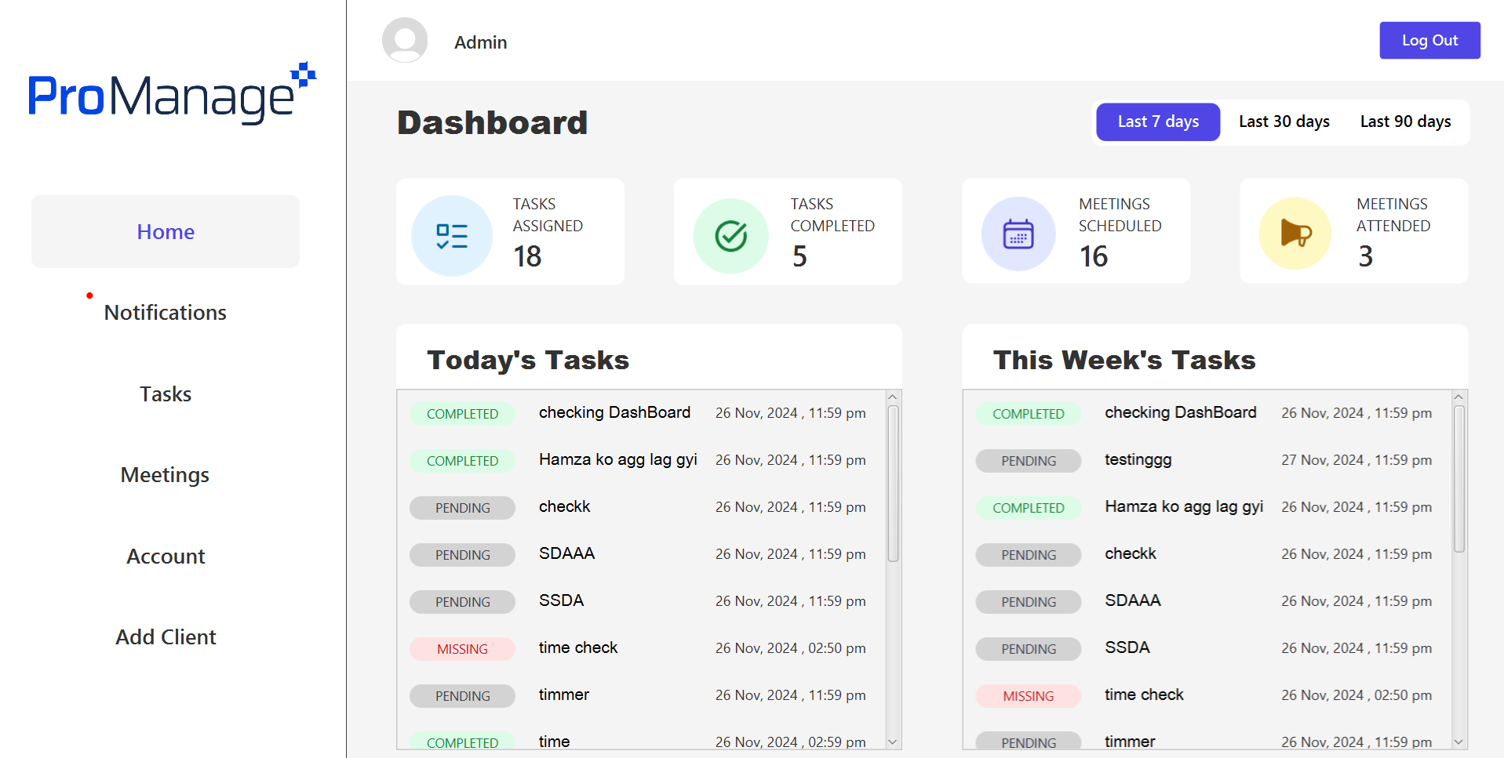
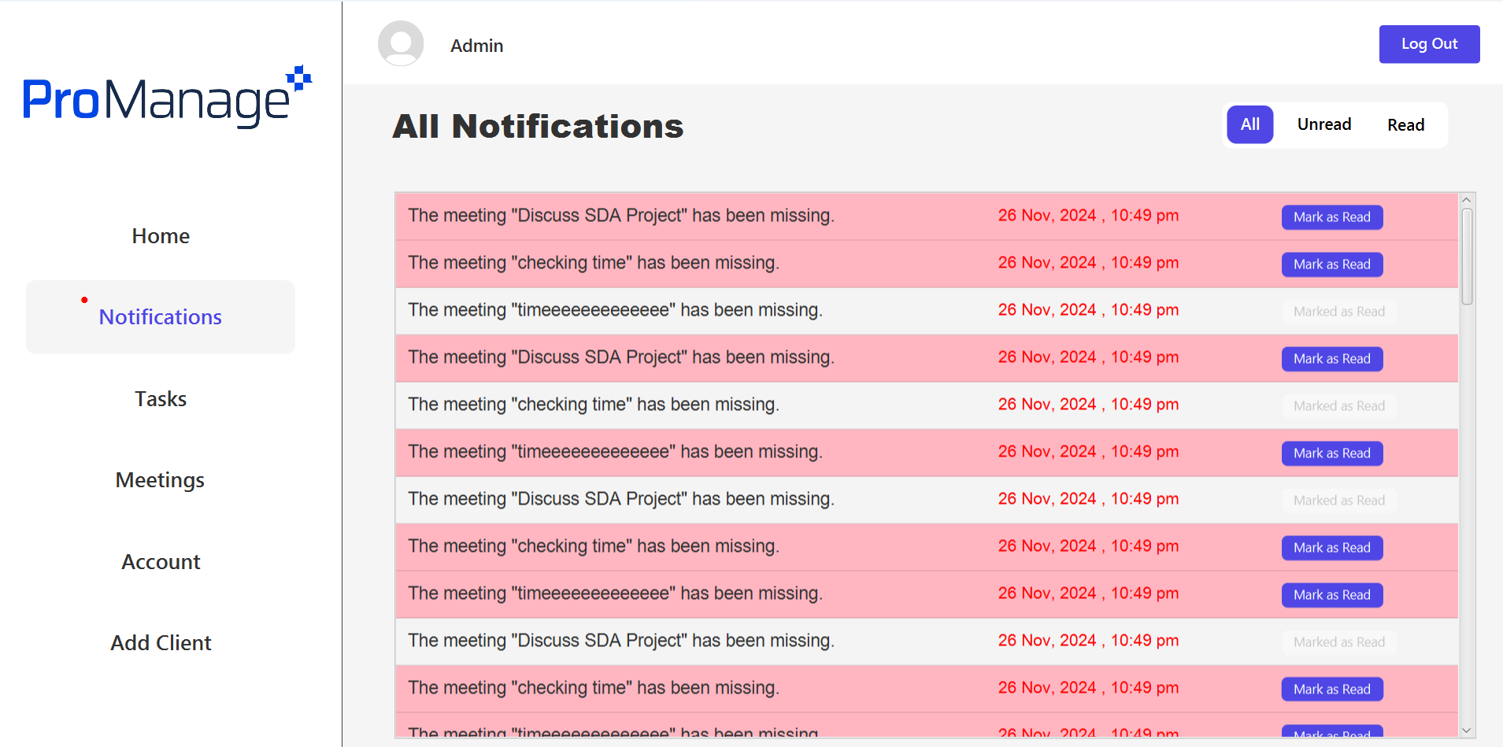
Screenshots of Project

Slide 18




Next Steps
1
Live Demo
2
Q&A
3
Feedback
4
Implementation

Slide 19

Thank You
We appreciate your time and interest in ProManage. This concludes our presentation on the key features and capabilities of our project management solution. We look forward to discussing next steps and addressing any questions you may have.

